Slide 1
BUS reservation backend system
Dbms mini preoject

Slide 2
PrOJECT partners
1) JIGNESH JINJALA (U18CO073)

Slide 3
Definition
We make a bus reservation backend system used by many government transportation commissions.
In this project, first of all we make ER-Diagram such that it gives basic structure of database.
Then we convert ER-Diagram into relational database.
And final part is Normalization such that we can take away the disadvantages such as redundancy and inconsistency in database so that we can make our process fast and save space for database such that we can store much data.

Slide 4
Er - diagram

Slide 5
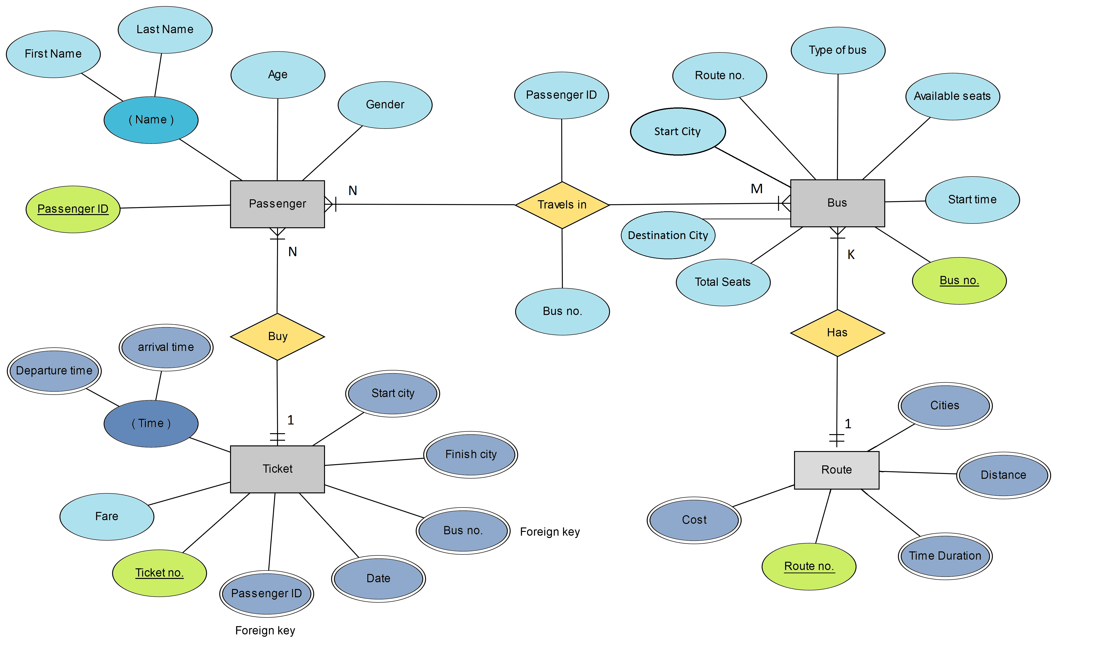

Slide 6
Explaination of er-diagram
ER-Diagram basically consists of 4 main Entities-sets and 3 binary relationships among them.
Each entity-sets consists of many attributes.
Primary and Foreign keys are presented by notation.
Some attributes are multivalued , derived etc.
Also Travels-In relationship consists attributes.

Slide 7
Explaination of er-diagram
Entity-sets:
1) BUS
2)TICKET
3)PASSENGER
4)ROUTE

Slide 8
Explaination of er-diagram
Relationships:
1)TRAVELS-IN(MANY-MANY RELATIONSHIPS BETWEEN PASSENGER AND BUS ENTITY-SETS
2)BUY(MANY-ONE RELATIONSHIP BETWEEN PASSENGER AND TICKET ENTITY-SETS)
3)HAS(MANY-ONE RELATIONSHIP BETWEEN BUS AND ROUTE ENTITY SETS)

Slide 9
Conversion of er-diagram into relational model

Slide 10
Passenger
PassengerID(PK)
FirstName
LastName
Age
Gender
Bus
BusNo(PK)
StartTime
AvailableSeats
TypeOfBus
RouteNo
StartCity
DestinationCity
TotalSeats
Route
RouteNo(PK)
Cost
TimeDuration
Distance
Cities
Ticket
TicketNo(PK)
StartCity
FinishCity
BusNo(FK)
Date
Fare
PassengerID(FK)
DepartureTime
ArrivalTime
PK – PRIMARY KEY
FK – FOREIGN KEY

Slide 11
normalization

Slide 12
Rules for normalization
1NF
No multivalued attributes
2NF
No partial dependencies
3NF
Either satisfy first or secong or both for FD (X Y) [No transitive dependencies]
1) X is a super key
2) Y is a prime attribute

Slide 13
Rules for normalization
BCNF
FOR (X Y) , X must be a super key
4NF
Has no mutivalued dependency
5NF
Not contains any join dependency & joining should be loseless
For the succeeding ones , they must first satisfy preceding ones.

Slide 14
Normalization concepts for Route(RouteNo , Cost , Distance , timdeduration , class)
Let take this relation as R(A , B , C , D , E) respectively for all attributes of Route.
Here the functional dependency is from (A BCDE).
The table is in 1NF as there is no multivalued attribute.
The table is in 2NF as there is no partial dependencies.
The table is in 3NF as there is no transitive depencies.
The table is in BCNF because A is a super key.

Slide 15
Normalization concepts for BUS(Busno.,starttime , availableseats , typeofbus , routeno.,startcity , destinationcity,totalseats)
Let take this relation as R(A , B , C , D , E , F , G , H) respectively for all attributes of Bus.
Here the functional dependency is from (A BCDEFGH).
The table is in 1NF as there is no multivalued attribute.
The table is in 2NF as there is no partial dependencies.
The table is in 3NF as there is no transitive depencies.
The table is in BCNF because A is a super key.

Slide 16
Normalization concepts for passenger(passengerid , firstname , lastname , age , gender)
Let take this relation as R(A , B , C , D , E) respectively for all attributes of Bus.
Here the functional dependency is from (A BCDE).
The table is in 1NF as there is no multivalued attribute.
The table is in 2NF as there is no partial dependencies.
The table is in 3NF as there is no transitive depencies.
The table is in BCNF because A is a super key.

Slide 17
Normalization concepts for ticket(ticketno. , passengerid , startcity , finishcity , busno. , date , fare , departuretime , arrivaltime)
Let take this relation as R(A , B , C , D , E , F , G , H , I) respectively for all attributes of Bus.
Here the functional dependency is from (A BCDEFGHI).
The table is in 1NF as there is no multivalued attribute.
The table is in 2NF as there is no partial dependencies.
The table is in 3NF as there is no transitive depencies.
The table is in BCNF because A is a super key.

Slide 18
CREATION OF TABLES

Slide 19
CODE
CREATE TABLE PASSENGER
(PASSENGER_ID NUMBER PRIMARY KEY,
FIRST_NAME VARCHAR(20) NOT NULL,
LAST_NAME VARCHAR(20),
AGE NUMBER,
GENDER VARCHAR(1));
CREATE TABLE TICKET(
TICKET_NO NUMBER PRIMARY KEY,
FARE NUMBER NOT NULL);

Slide 20
CREATE TABLE TICKET_P(
TICKET_NO NUMBER,
PASSENGER_ID NUMBER,
CONSTRAINT TICKET_P_PK PRIMARY KEY(TICKET_NO , PASSENGER_ID));
CREATE TABLE TICKET_B(
BUS_NO NUMBER,
TICKET_NO NUMBER,
DATE_B DATE,
BOARDING_CITY VARCHAR(20),
DROP_CITY VARCHAR(20),
START_J_TIME TIMESTAMP,
FINISH_J_TIME TIMESTAMP,
CONSTRAINT TICKET_B_PK PRIMARY KEY(BUS_NO , TICKET_NO));

Slide 21
CREATE TABLE BUS(
BUS_NO NUMBER PRIMARY KEY,
TYPE VARCHAR(10),
START_TIME DATE,
TOTAL_SEAT NUMBER,
RATE_PKM NUMBER);
CREATE TABLE BUS_C(
BUS_NO NUMBER,
CITY VARCHAR(20),
TIMEC DATE,
SEAT_AV NUMBER,
DISTANCE NUMBER,
CONSTRAINT BUS_C_PK PRIMARY KEY(BUS_NO , CITY));

Slide 22
Basic operations

Slide 23
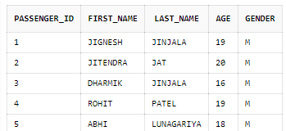
Insert into passenger
INSERT INTO PASSENGER VALUES(1 , 'JIGNESH' , 'JINJALA' , 19 , 'M');
INSERT INTO PASSENGER VALUES(2 , 'JITENDRA' , 'JAT' , 20 , 'M');
INSERT INTO PASSENGER VALUES(3 , 'DHARMIK' , 'JINJALA' , 16 , 'M');
INSERT INTO PASSENGER VALUES(4 , 'ROHIT' , 'BAKOLIYA' , 19 , 'M');
INSERT INTO PASSENGER VALUES(5 , 'ABHI' , 'LUNAGARIYA' , 18 , 'M');
SELECT * FROM PASSENGER

Slide 24
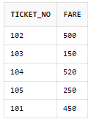
Insert into ticket
INSERT INTO TICKET VALUES(101 , 450);
INSERT INTO TICKET VALUES(102 , 500);
INSERT INTO TICKET VALUES(103 , 150);
INSERT INTO TICKET VALUES(104 , 520);
INSERT INTO TICKET VALUES(105 , 250);
SELECT * FROM TICKET;

Slide 25
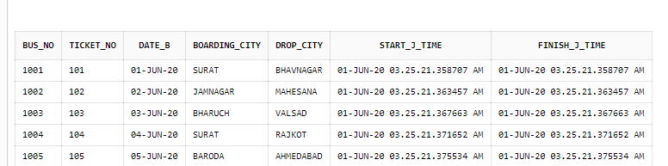
Insert into ticket_b
INSERT INTO TICKET_B VALUES(1001 , 101 , DATE '2020-06-01' , 'SURAT' , 'BHAVNAGAR' , (CURRENT_TIMESTAMP) , (CURRENT_TIMESTAMP));
INSERT INTO TICKET_B VALUES(1002 , 102 , DATE '2020-06-02' , 'JAMNAGAR' , 'MAHESANA' , (CURRENT_TIMESTAMP) , (CURRENT_TIMESTAMP));
INSERT INTO TICKET_B VALUES(1003 , 103 , DATE '2020-06-03' , 'BHARUCH' , 'VALSAD' , (CURRENT_TIMESTAMP) , (CURRENT_TIMESTAMP));
INSERT INTO TICKET_B VALUES(1004 , 104 , DATE '2020-06-04' , 'SURAT' , 'RAJKOT' , (CURRENT_TIMESTAMP) , (CURRENT_TIMESTAMP));
INSERT INTO TICKET_B VALUES(1005 , 105 , DATE '2020-06-05' , 'BARODA' , 'AHMEDABAD' , (CURRENT_TIMESTAMP) , (CURRENT_TIMESTAMP));
SELECT * FROM TICKET_B;

Slide 26
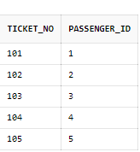
Insert into ticket_p
INSERT INTO TICKET_P VALUES(101 , 1);
INSERT INTO TICKET_P VALUES(102 , 2);
INSERT INTO TICKET_P VALUES(103 , 3);
INSERT INTO TICKET_P VALUES(104 , 4);
INSERT INTO TICKET_P VALUES(105 , 5);
SELECT * FROM TICKET_P;

Slide 27
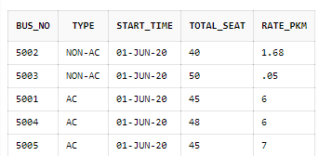
Insert into bus
INSERT INTO BUS VALUES(5001 , 'AC' , CURRENT_TIMESTAMP , 45 , 6);
INSERT INTO BUS VALUES(5002 , 'NON-AC' , CURRENT_TIMESTAMP , 40 , 8);
INSERT INTO BUS VALUES(5003 , 'NON-AC' , CURRENT_TIMESTAMP , 50 , 5);
INSERT INTO BUS VALUES(5004 , 'AC' , CURRENT_TIMESTAMP , 48 , 6);
INSERT INTO BUS VALUES(5005 , 'AC' , CURRENT_TIMESTAMP , 45 , 7);
SELECT * FROM BUS;

Slide 28
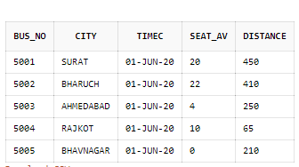
Insert into bus_c
INSERT INTO BUS_C VALUES(5001 , 'SURAT' , CURRENT_TIMESTAMP , 20 , 450);
INSERT INTO BUS_C VALUES(5002 , 'BHARUCH' , CURRENT_TIMESTAMP , 22 , 410);
INSERT INTO BUS_C VALUES(5003 , 'AHMEDABAD' , CURRENT_TIMESTAMP , 4 , 250);
INSERT INTO BUS_C VALUES(5004 , 'RAJKOT' , CURRENT_TIMESTAMP , 10 , 65);
INSERT INTO BUS_C VALUES(5005 , 'BHAVNAGAR' , CURRENT_TIMESTAMP , 0 , 210);
SELECT * FROM BUS_C;

Slide 29

Delelte from bus
DELETE FROM BUS
WHERE TYPE = 'AC';
SELECT *
FROM BUS;

Slide 30

Modify rate_pkm in bus
UPDATE BUS
SET RATE_PKM = RATE_PKM + 10*RATE_PKM/100;
SELECT *
FROM BUS;

Slide 31
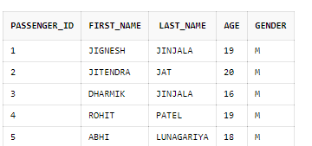
Update last_name in passenger
UPDATE PASSENGER
SET LAST_NAME = 'PATEL'
WHERE PASSENGER_ID = 4;
SELECT *
FROM PASSENGER;

Slide 32
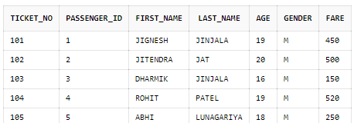
Natural join
SELECT *
FROM PASSENGER NATURAL JOIN TICKET_P NATURAL JOIN TICKET;

Slide 33
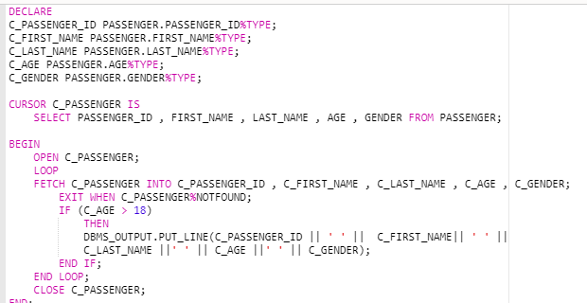
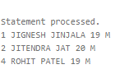
cursor

Slide 34
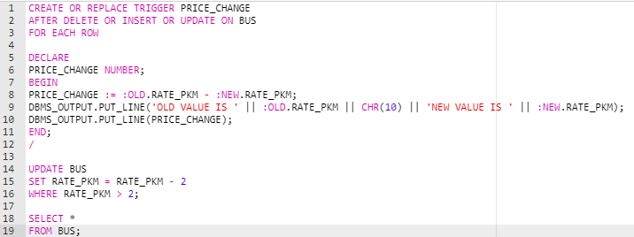
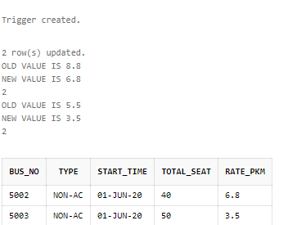
trigger

Slide 35
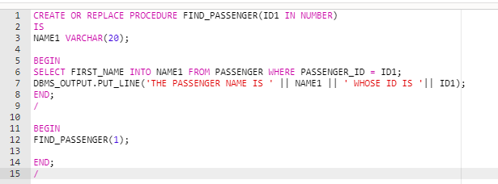
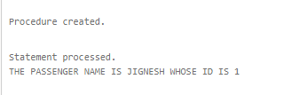
procedure

Slide 36
The end

